Slide 1
UNIVERSITY INSTITUTE OF ENGINEERING
COMPUTER SCIENCE ENGINEERING
Master of Engineering
ADVANCED DATA STRUCTURES
&
ALGORITHMS
(23CSH-622)
INTRODUCTION
DISCOVER . LEARN . EMPOWER

Slide 2

ADVANCED DATA STRUCTURES
&
ALGORITHMS
(23CSH-622)
By : Dr. Ranjit Singh (E10947)
www. cuchd.in Campus : Gharaun, Mohali

Slide 3
Contents of the Syllabus
UNIT-I (15h)
Introduction to Basic Data Structures: Importance and need of good data structures and algorithms, Introduction to linear and non-linear data structure and its importance, Algorithms Complexity and Analysis. [3]
Linear and Non –Linear Data Structures : Arrays , Link Lists, Queues , Trees and related algorithms [6]
Advanced Data Structures: AVL Trees (Insertion , Deletion , Searching), Red-Black Trees, B-trees, B+trees, Heaps. Data structure for disjoint sets, Augmented data structures. [6]
UNIT-II (15h)
Searching and Sorting : Internal and External Sorting algorithms: Linear Search, Binary Search, Bubble Sort, Selection Sort, Insertion Sort, Shell Sort, Quick Sort, Heap Sort, Merge Sort, Counting Sort, Radix Sort and analysis of their complexities and Hashing [4]
Graphs & Algorithms: Representation, Type of Graphs, Depth- and breadth-first traversals, Planar graphs, isomorphism, graph coloring, covering and partition, Minimum Spanning Tree: Prim’s and Kruskal’s algorithms. [6]
String Matching Algorithms: Naïve String Matching, Suffix arrays, Suffix trees, Rabin-Karp, Knuth-Morris-Pratt, Booyer-Moore algorithm [5]

Slide 4
Contents of the Syllabus
UNIT-III (15h)
Approximation algorithms: Need of approximation algorithms: Introduction to P, NP, NP-Hard and NP-Complete Greedy Approach, Dynamic Approach, Knapsack, Huffman Coding, TSP, All pair shortest path, Longest Common Subsequence Problem, Matrix Chain Multiplication. [7]
Randomized algorithms: Introduction, type of randomized algorithms, Quick sort, min cut [4]
Online Algorithms: Introduction, Online Paging Problem, k-server Problem. Data compression: Huffman’s coding, BWT, LZW [4]
Recommended Books:
1. Cormen, Leiserson, Rivest, Stein, “Introduction to Algorithms”, Prentice Hall of India, 3rd edition 2012.
2. Horowitz, Sahni and Rajasekaran, “Fundamental of Computer, Algorithms”, University Press (India), 2nd edition.
3. Aho, Haperoft and Ullman, “The Design and analysis of Computer Algorithms”, Pearson Education India.

Slide 5
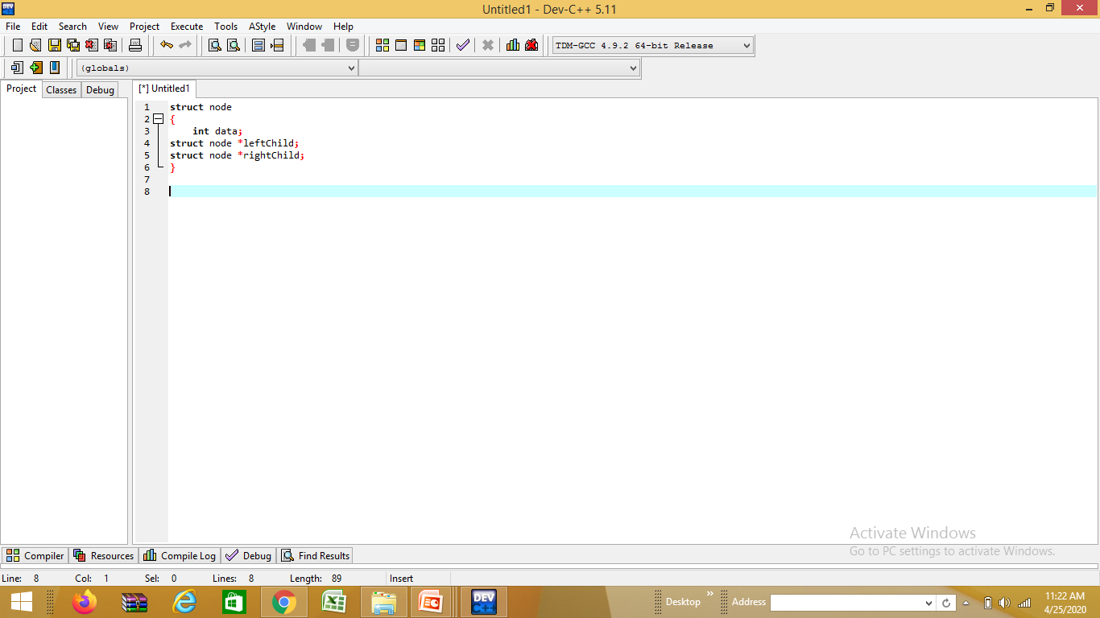
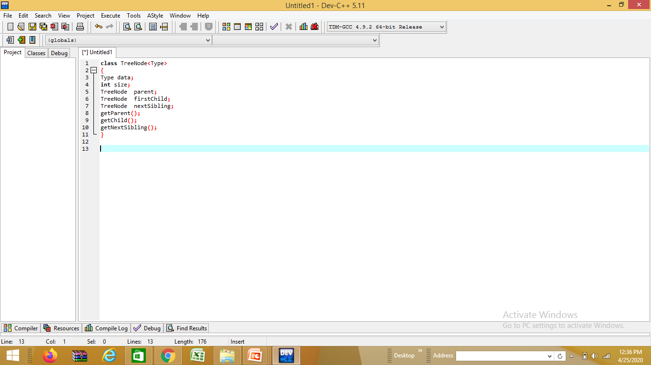
Tree Definition
Tree is a hierarchical data structure which stores the information naturally in the form of hierarchy style.
Tree is one of the most powerful and advanced data structures.
It is a non-linear data structure compared to arrays, linked lists, stack and queue.
It represents the nodes connected by edges.
The first node from where the tree originates is called as a root node.
In any tree, there must be only one root node.

Slide 6
Properties of Tree
There is one and only one path between every pair of vertices in a tree.
A tree with n vertices has exactly (n-1) edges.
A graph is a tree if and only if it is minimally connected.
Any connected graph with n vertices and (n-1) edges is a tree.

Slide 7
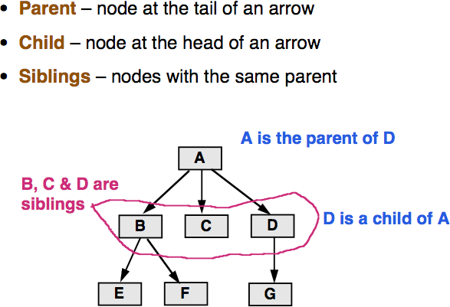
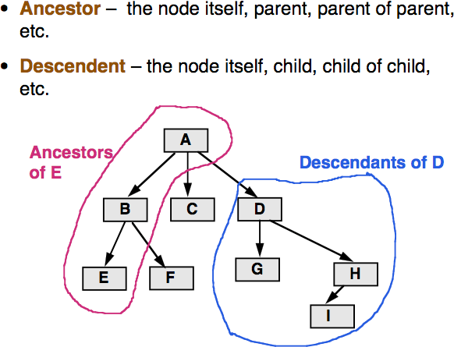
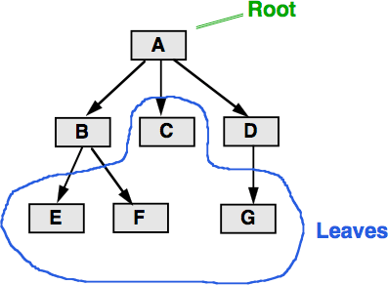
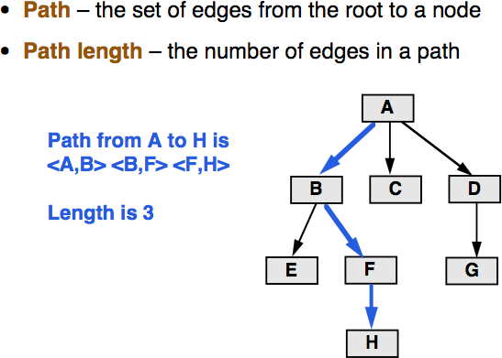
Terminology

Slide 8
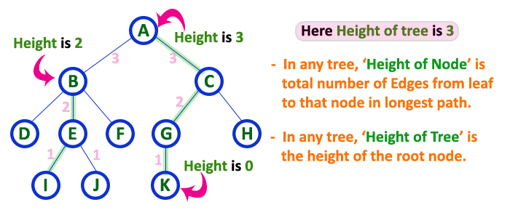
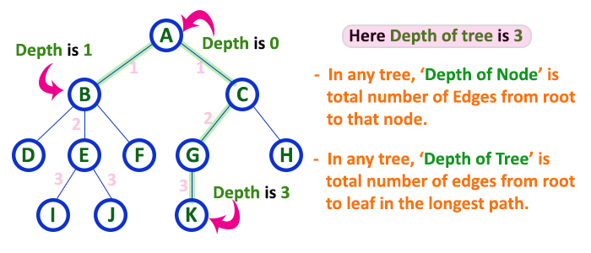
Terminology
Height of Tree:
The total number of edges from leaf node to a particular node in the longest path is called as HEIGHT of that Node. In a tree, height of the root node is said to be height of the tree. In a tree, height of all leaf nodes is '0'.
Depth of Tree:
The total number of edges from root node to a particular node is called as DEPTH of that Node. In a tree, the total number of edges from root node to a leaf node in the longest path is said to be Depth of the tree. In a tree, depth of the root node is 0.

Slide 9
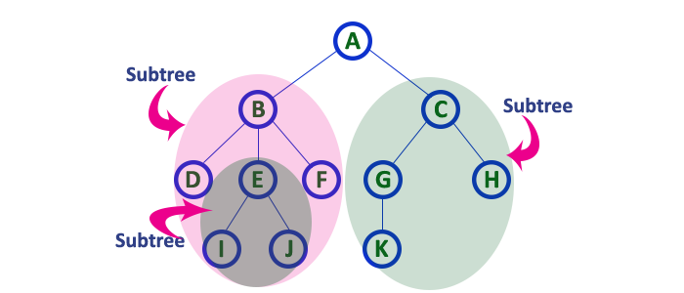
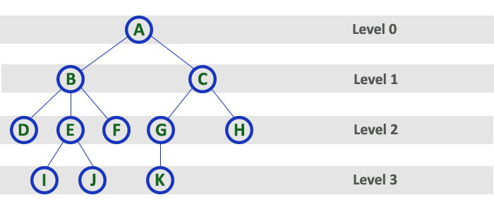
Terminology
Sub Tree
In a tree data structure, each child from a node forms a sub tree recursively. Every child node will form a sub tree on its parent node.
Level: The root node is said to be at Level 0 and the children of root node are at Level 1 and the children of the nodes which are at Level 1 will be at Level 2 and so on... In simple words, in a tree each step from top to bottom is called as a Level and the Level count starts with '0' and incremented by one at each level

Slide 10
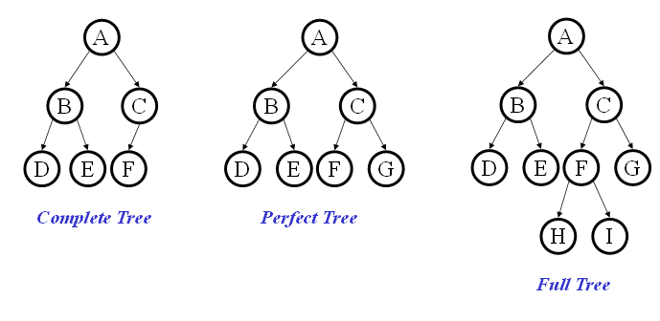
Binary Tree
Binary tree: each node has at most two children.
The possible children are usually referred to as the left child and the right child
Binary tree is
A root (with data)
A left subtree (may be empty)
A right subtree (may be empty)

Slide 11
Binary Tree Representations
If a complete binary tree with n nodes (depth = log n + 1) is represented sequentially, then for any node with index i, 1<=i<=n, we have:
parent(i) is at i/2 if i!=1. If i=1, i is at the root and has no parent.
left_child(i) ia at 2i if 2i<=n. If 2i>n, then i has no left child.
right_child(i) ia at 2i+1 if 2i +1 <=n. If 2i +1 >n, then i has no right child.

Slide 12
Sequential Representation
[1]
[2]
[3]
[4]
[5]
[6]
[7]
[8]
[9]
A
B
C
D
E
F
G
H
I
(1) waste space
(2) insertion/deletion
problem
A
[1]
[2]
[3]
[4]
[5]
[6]
[7]
[8]
[9]
.
[16]
A
B
--
C
--
--
--
D
--
.
E
B
A
C
B
C
D
E
D
E
F
G
H
I

Slide 13
Linked Representation
typedef struct node *tree_pointer;
typedef struct node {
int data;
tree_pointer left_child, right_child;
};
data
left_child
data
right_child
left_child
right_child

Slide 14
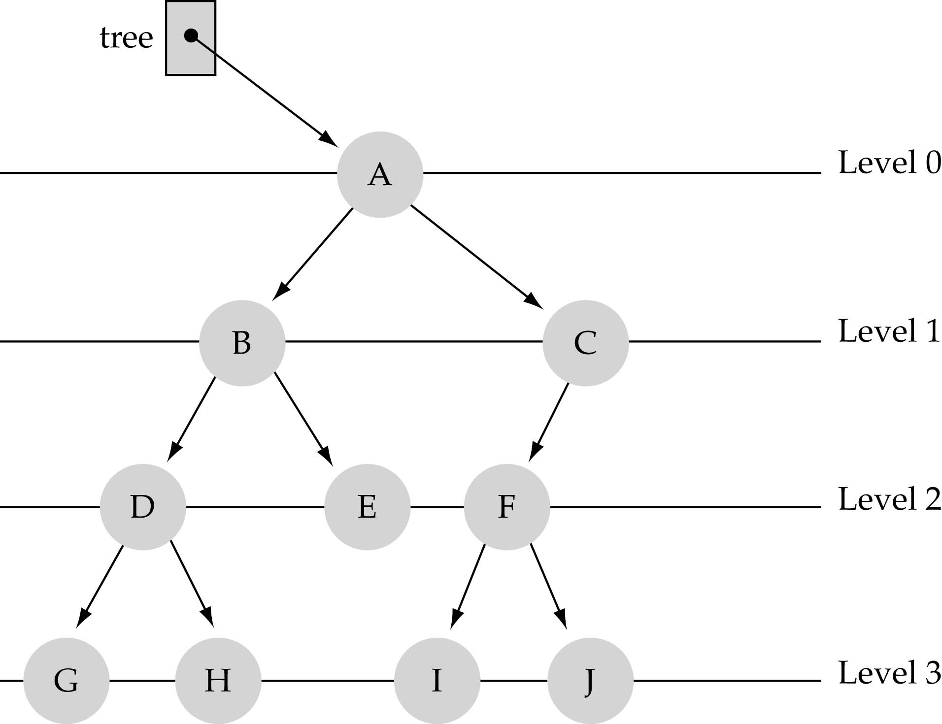
What is the max #nodes at some level l?
The max #nodes at level is
where l=0,1,2, ...,L-1

Slide 15
Traversals
A traversal is a process that visits all the nodes in the tree. Since a tree is a nonlinear data structure, there is no unique traversal. We will consider several traversal algorithms with we group in the following two kinds:-
depth-first traversal
breadth-first traversal
There are three different types of depth-first traversals:-
PreOrder traversal - visit the parent first and then left and right children;
InOrder traversal - visit the left child, then the parent and the right child;
PostOrder traversal - visit left child, then the right child and then the parent;

Slide 16
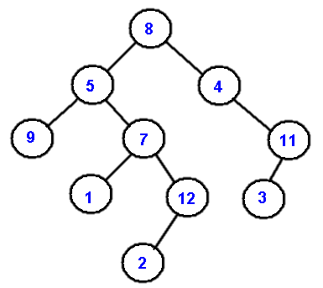
Example: Traversals
As an example consider the following tree and its four traversals:
PreOrder
InOrder
PostOrder
LevelOrder

Slide 17
Example: Traversals
As an example consider the following tree and its four traversals:
PreOrder - 8, 5, 9, 7, 1, 12, 2, 4, 11, 3
InOrder - 9, 5, 1, 7, 2, 12, 8, 4, 3, 11
PostOrder - 9, 1, 2, 12, 7, 5, 3, 11, 4, 8
LevelOrder - 8, 5, 4, 9, 7, 11, 1, 12, 3, 2

Slide 18
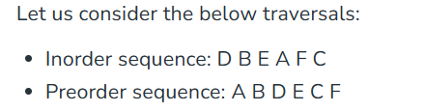
Construct Tree from given Inorder and Preorder traversals

Slide 19
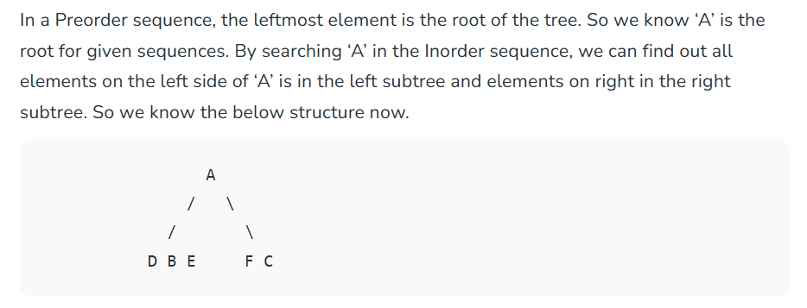
Construct Tree from given Inorder and Preorder traversals

Slide 20
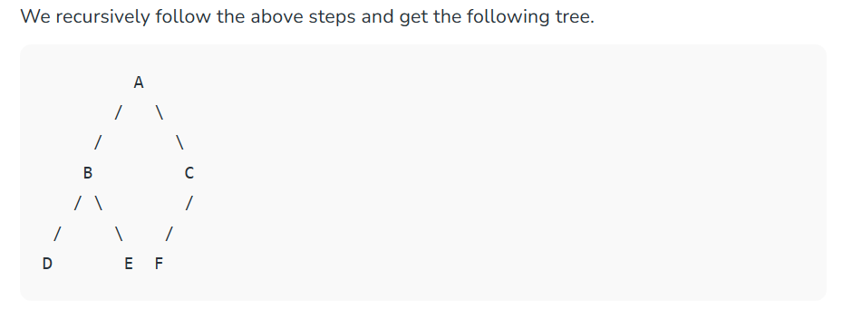
Construct Tree from given Inorder and Preorder traversals

Slide 21
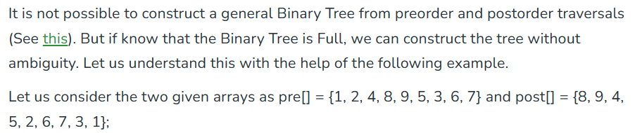
Construct Full Binary Tree from given preorder and postorder traversals

Slide 22
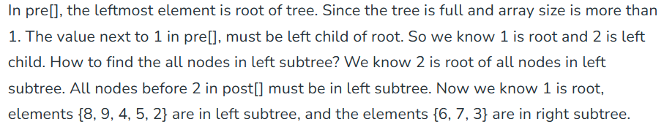
Construct Full Binary Tree from given preorder and postorder traversals

Slide 23
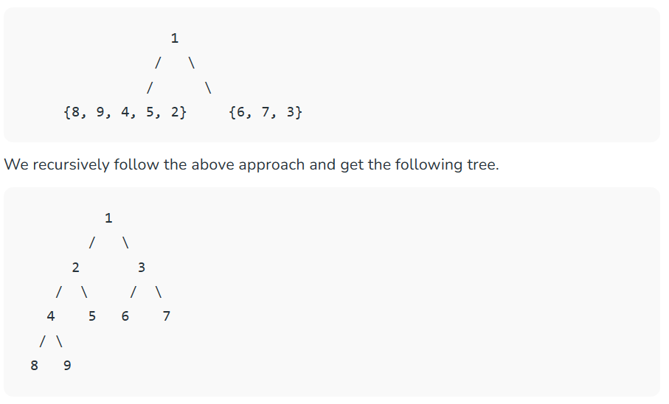
Construct Full Binary Tree from given preorder and postorder traversals

Slide 24
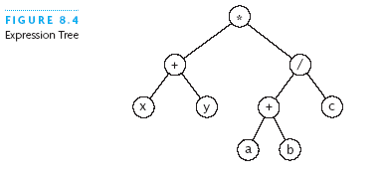
Expression Tree
(x + y) * ((a + b) / c)
Each node contains an operator or an operand
Operands are stored in leaf nodes
Parentheses are not stored in the tree because the tree structure dictates the order of operand evaluation
Operators in nodes at higher tree levels are evaluated after operators in nodes at lower tree levels

Slide 25
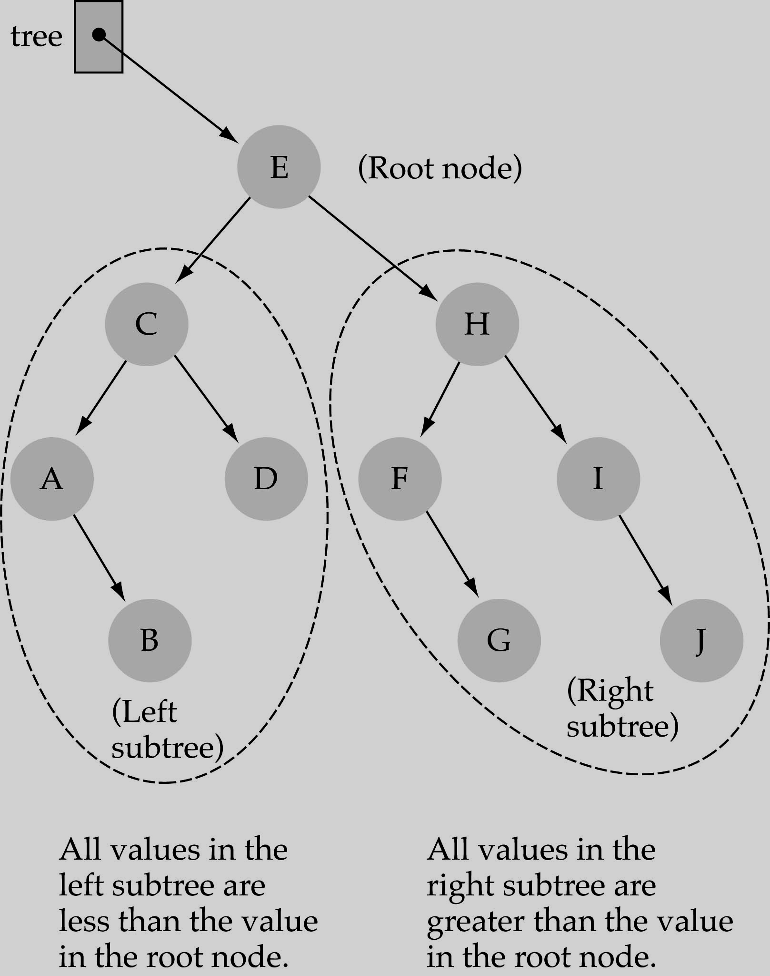
Binary Search Trees (BSTs)
In a BST, the value stored at the root of a subtree
is greater than any value in its left subtree and
less than any value in its right subtree.
Binary Search Tree Property:
The value stored at a node is greater than
the value stored at its left child and less than
the value stored at its right child.
Where is the smallest element?
Ans: ?
Where is the largest element?
Ans: ?

Slide 26
Binary Search Trees (BSTs)
In a BST, the value stored at the root of a subtree
is greater than any value in its left subtree and
less than any value in its right subtree.
Binary Search Tree Property:
The value stored at a node is greater than
the value stored at its left child and less than
the value stored at its right child.
Where is the smallest element?
Ans: leftmost element
Where is the largest element?
Ans: rightmost element

Slide 27
How to search a binary search tree?
(1) Start at the root
(2) Compare the value of the item you are searching for with the value stored at the root
(3) If the values are equal, then item found; otherwise, if it is a leaf node, then not found
(4) If it is less than the value stored at the root, then search the left subtree
(5) If it is greater than the value stored at the root, then search the right subtree
(6) Repeat steps 2-6 for the root of the subtree chosen in the previous step 4 or 5
Q. Is this better than searching a linked list?

Slide 28
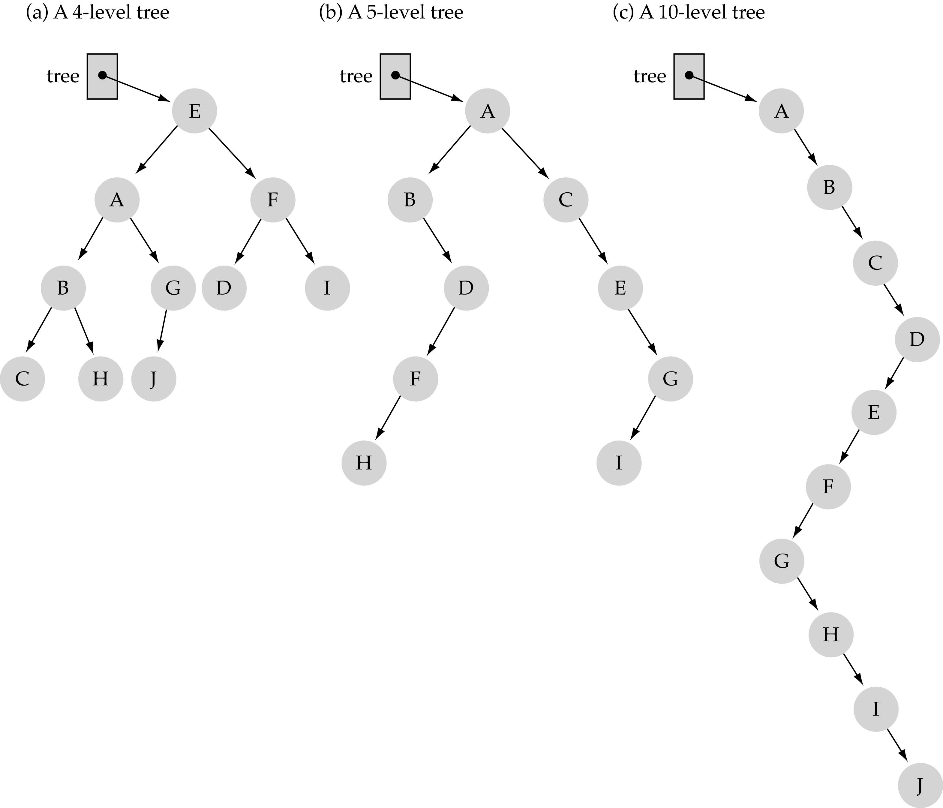
What is the max height of a tree with N nodes?
What is the min height of a tree with N nodes?

Slide 29
What is the max height of a tree with N nodes?
N (same as a linked list)
What is the min height of a tree with N nodes?
log(N+1)

Slide 30
What is the total #nodes N of a full tree with height h?
l=0
l=1
l=h-1
using the geometric series:

Slide 31
What is the height h of a full tree with N nodes?

Slide 32
Querying a Binary Search Tree
All dynamic-set search operations can be supported in O(h) time.
h = O(log n) for a balanced binary tree (and for an average tree built by adding nodes in random order.)
h = O(n) for an unbalanced tree that resembles a linear chain of n nodes in the worst case.

Slide 33
Balanced Trees

Slide 34
Adelson-Velskii and Landis (AVL) trees
AVL trees are height-balanced binary search trees.
Balance factor of a node
height(left subtree) - height(right subtree)
An AVL tree has balance factor calculated at every node
For every node, heights of left and right subtree can differ by no more than 1
Store current heights in each node

Slide 35
AVL Tree Data Structure
3
10
data
10
3
height
1
2
children
5
15
0
0
0
1
2
9
12
20
0
0
17
30
Notes:
Here’s a revision of that tree that’s balanced. (Same values, similar tree)
This one _is_ an AVL tree (and isn’t leftist).
I also have here how we might store the nodes in the AVL tree.
Notice that I’m going to keep track of height all the time. WHY?

Slide 36
Pros and Cons of AVL Trees
Pro:
All operations guaranteed O(log N)
The height balancing adds no more than a constant factor to the speed of insertion
Con:
Space consumed by height field in each node
Slower than ordinary BST on random data
Can we guarantee O(log N) performance with less overhead?

Slide 37
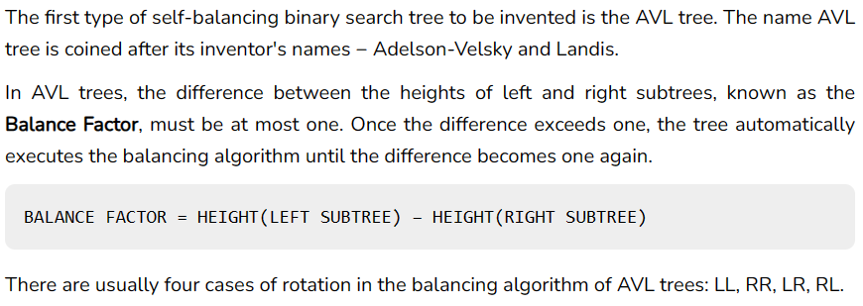
AVL Tree Rotations

Slide 38
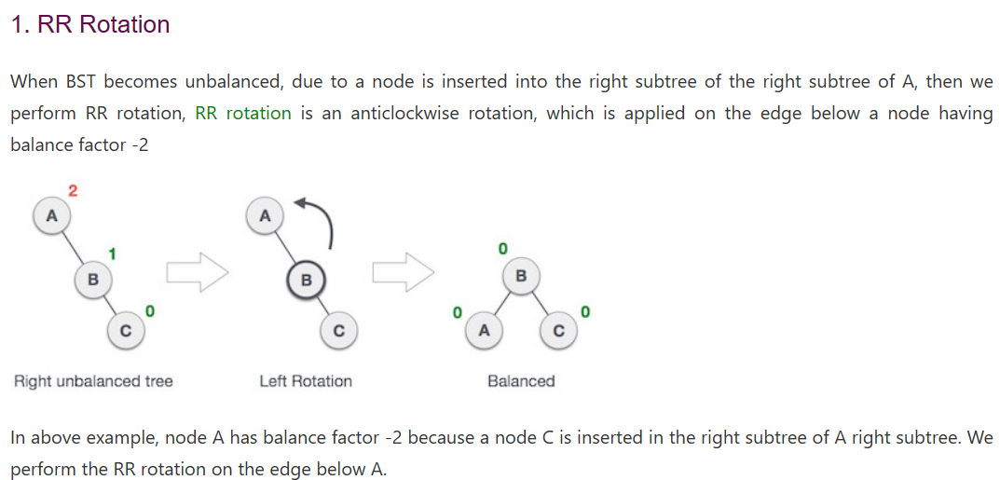
AVL Tree Rotations- RR

Slide 39
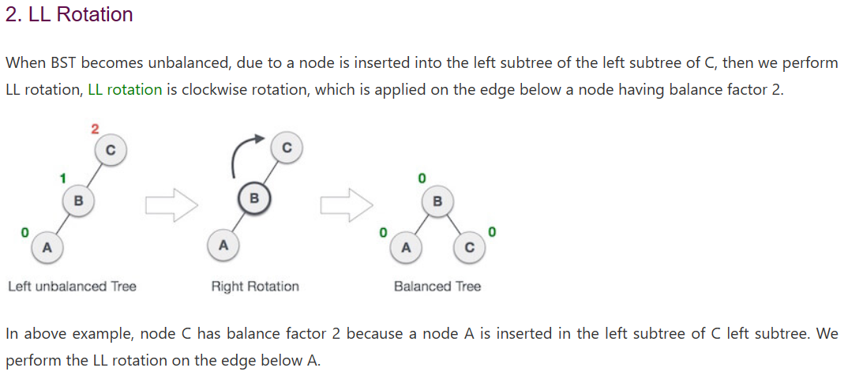
AVL Tree Rotations- LL

Slide 40
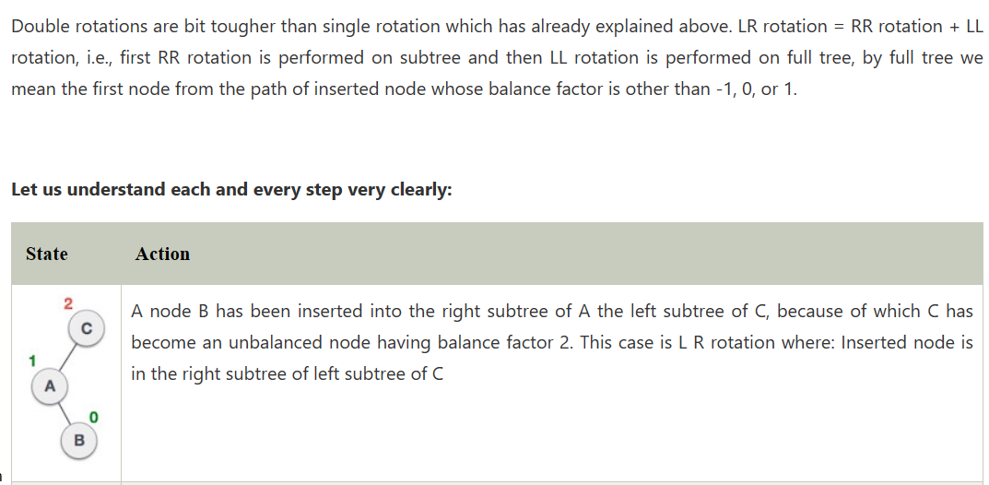
AVL Tree Rotations- LR

Slide 41
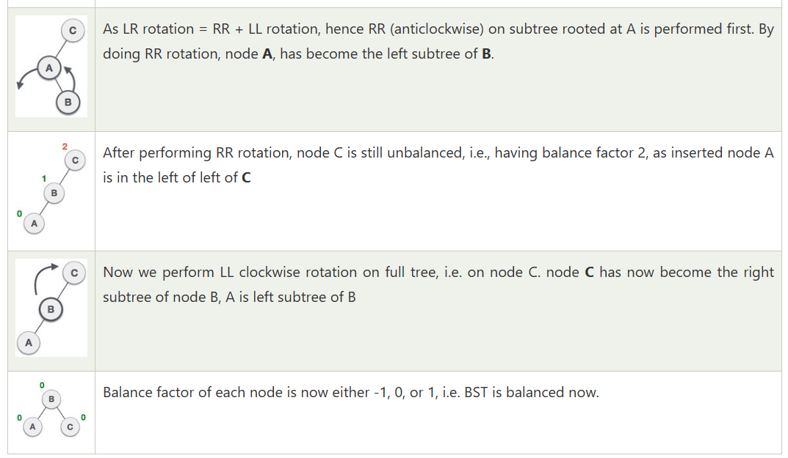
AVL Tree Rotations- LR

Slide 42
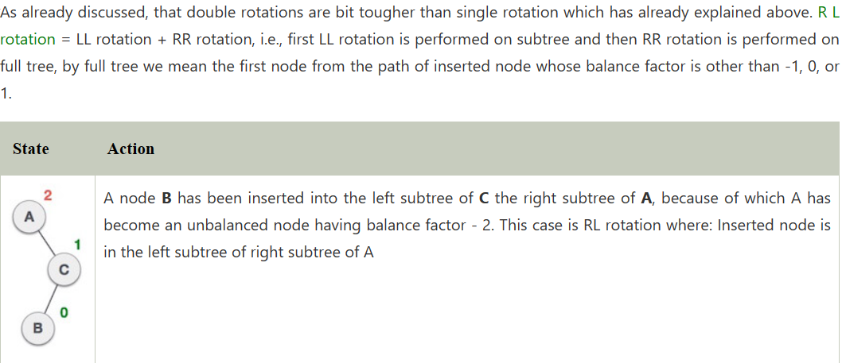
AVL Tree Rotations- RL

Slide 43
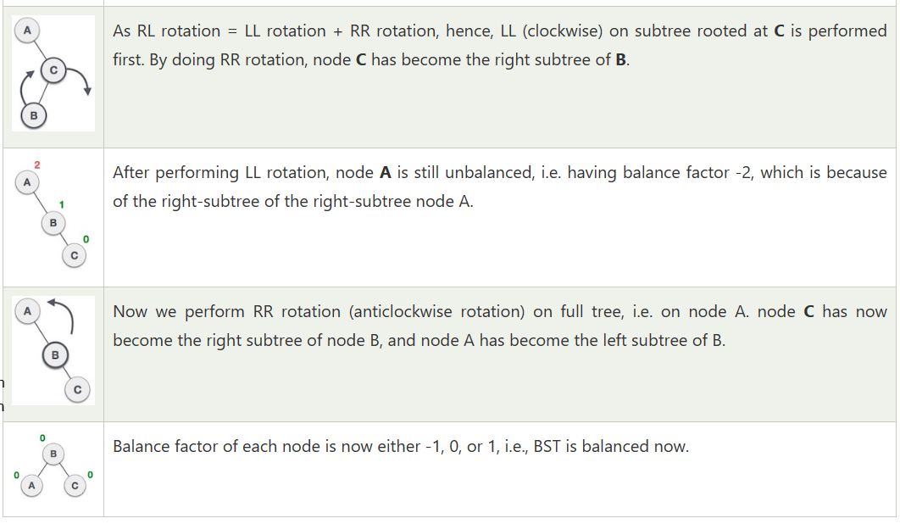
AVL Tree Rotations- RL

Slide 44
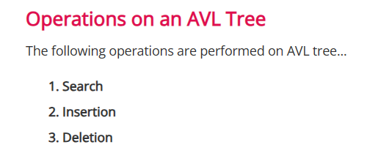
AVL Tree

Slide 45
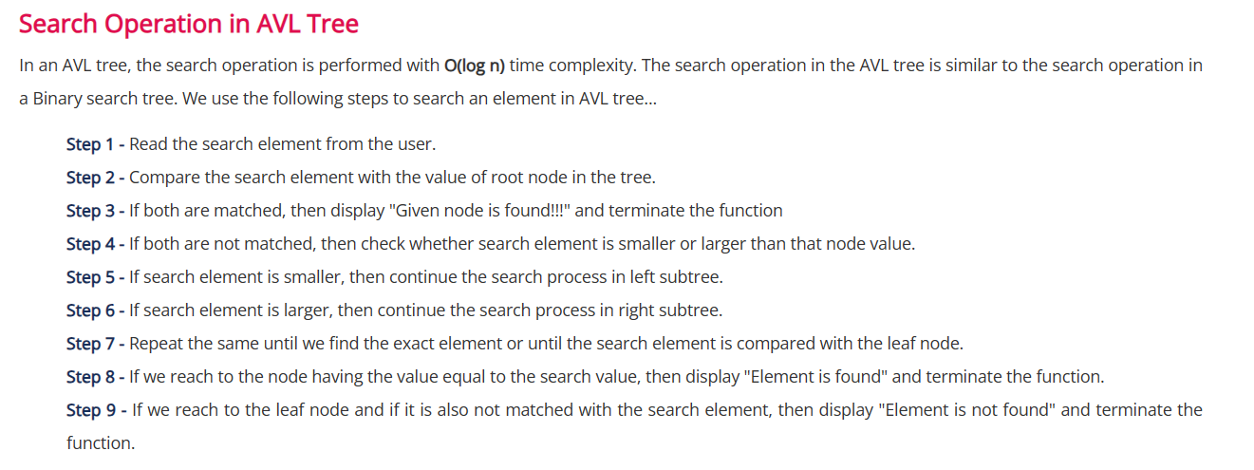
AVL Tree

Slide 46
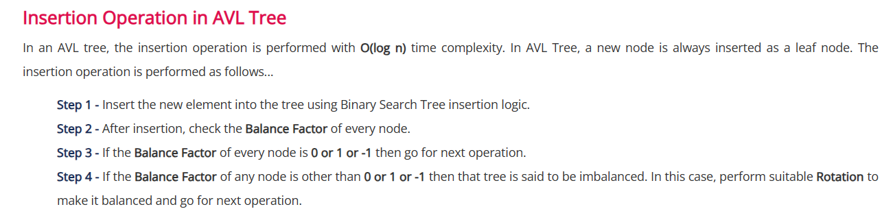
AVL Tree

Slide 47
AVL Tree

Slide 48
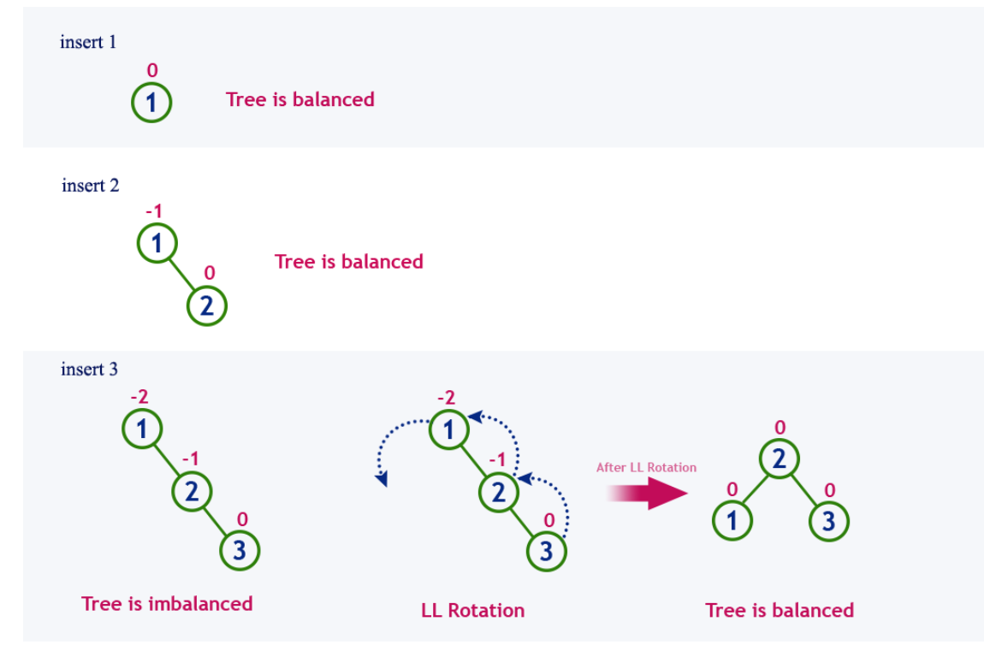
AVL Tree

Slide 49
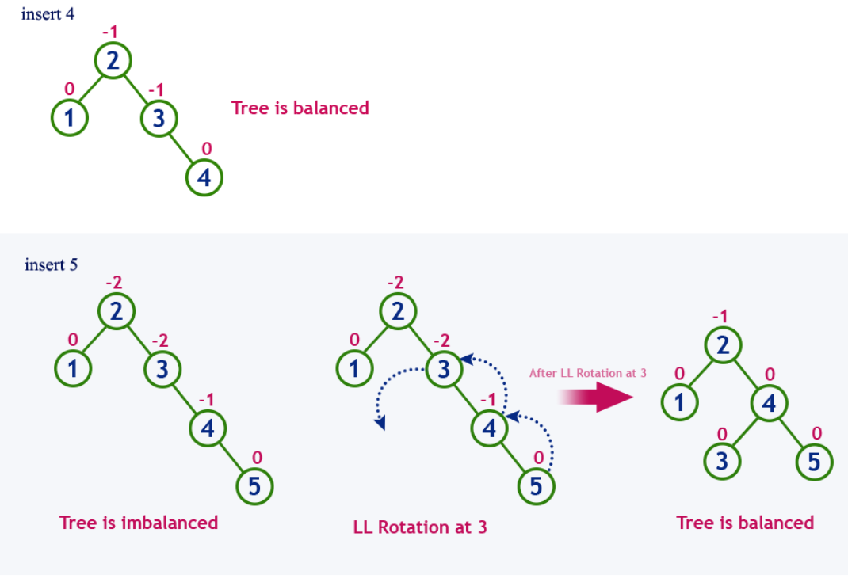
AVL Tree

Slide 50
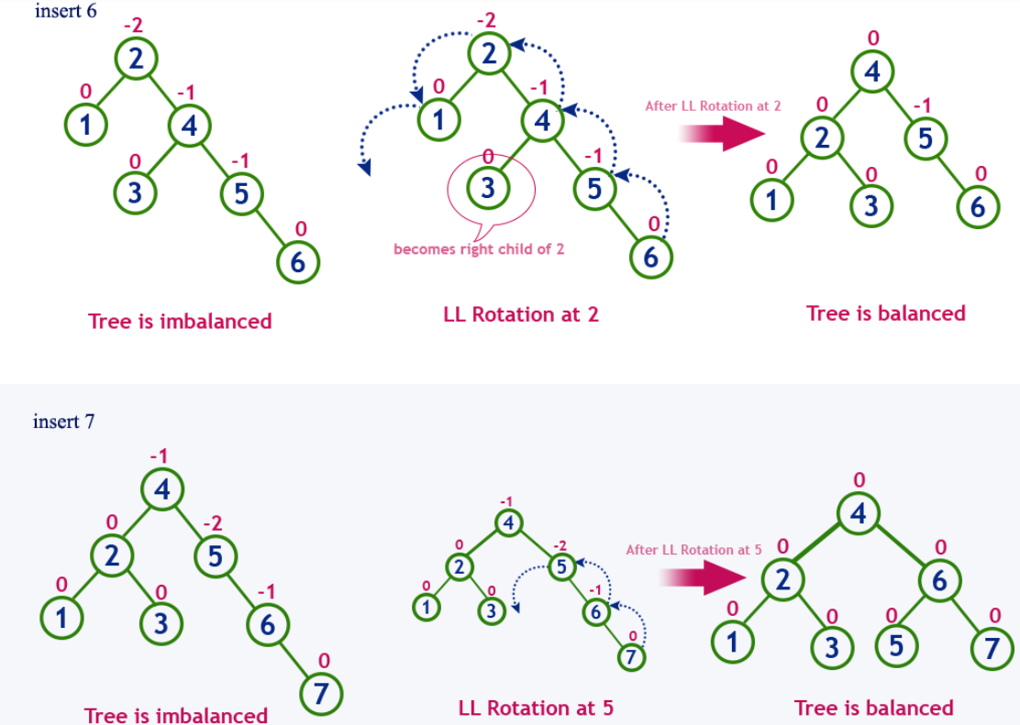
AVL Tree

Slide 51
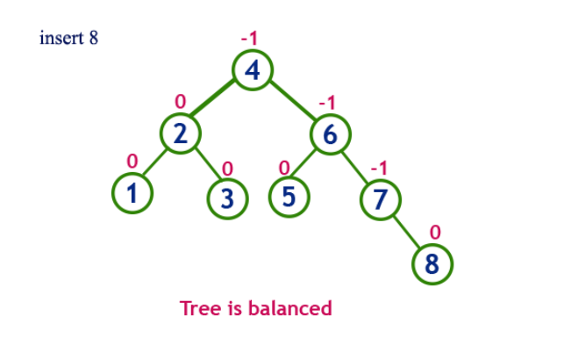
AVL Tree

Slide 52
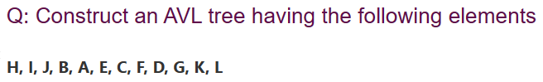

Slide 53
Red-black trees
Red-black trees are a variation of binary search trees to ensure that the tree is balanced.
Height is O(log n), where n is the number of nodes.
Operations take O(log n) time in the worst case.

Slide 54
The height of red-black tree
The black-height of a node, x, in a red-black tree is the number of black nodes on any path to a leaf, not counting x.
Black-Height of the root =
2

Slide 55
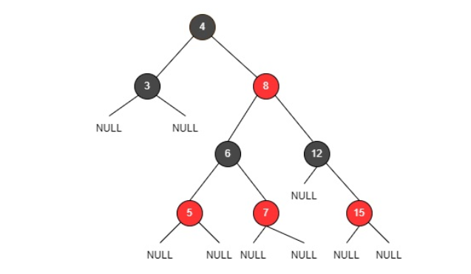
Red-Black Trees
Rules That Every Red-Black Tree Follows:
Property #1: Red - Black Tree must be a Binary Search Tree.
Property #2: The ROOT node must be colored BLACK.
Property #3: The children of Red colored node must be colored BLACK. (There should not be two consecutive RED nodes).
Property #4: In all the paths of the tree, there should be same number of BLACK colored nodes.
Property #5: Every new node must be inserted with RED color.
Property #6: Every leaf (e.i. NULL node) must be colored BLACK.
Purpose: keep the tree balanced.

Slide 56
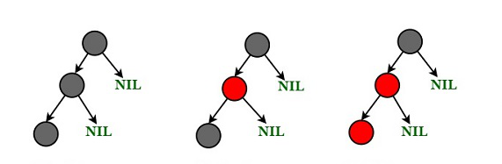
Red-Black Tree with 3 nodes ?

Slide 57
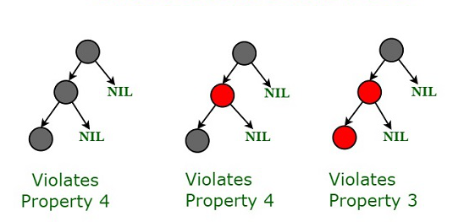
Red-Black Tree with 3 nodes

Slide 58
Possible Red-Black Trees with 3 nodes ?

Slide 59
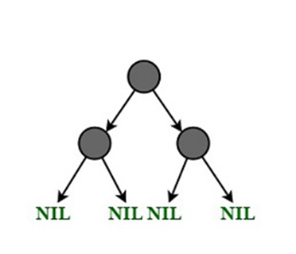
Possible Red-Black Trees with 3 nodes

Slide 60
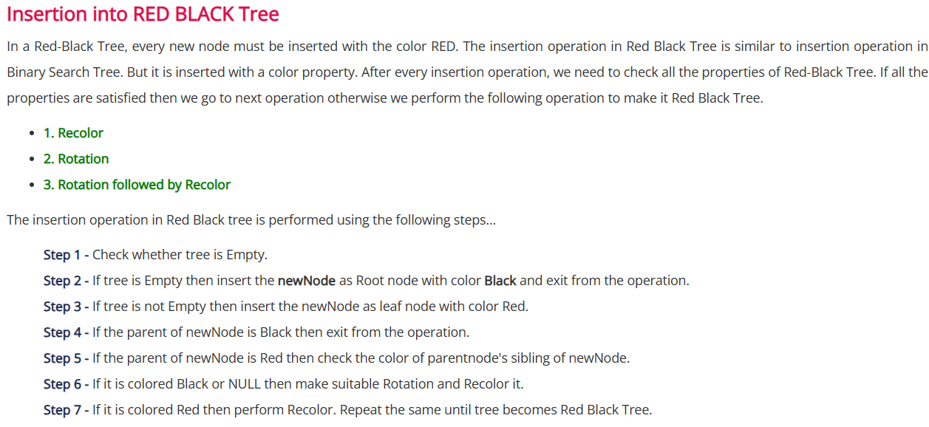

Slide 61


Slide 62
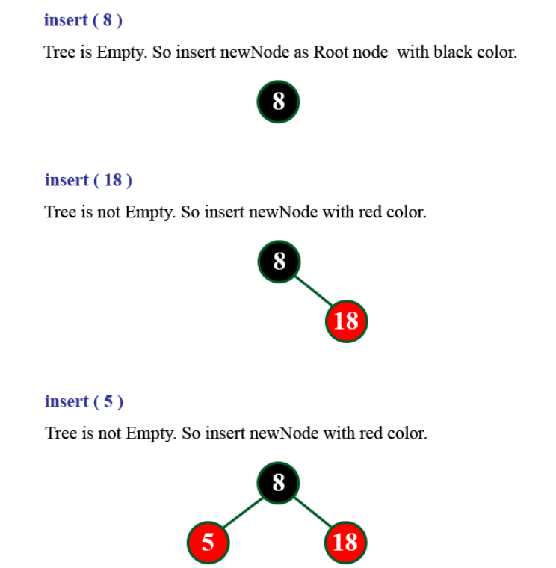

Slide 63
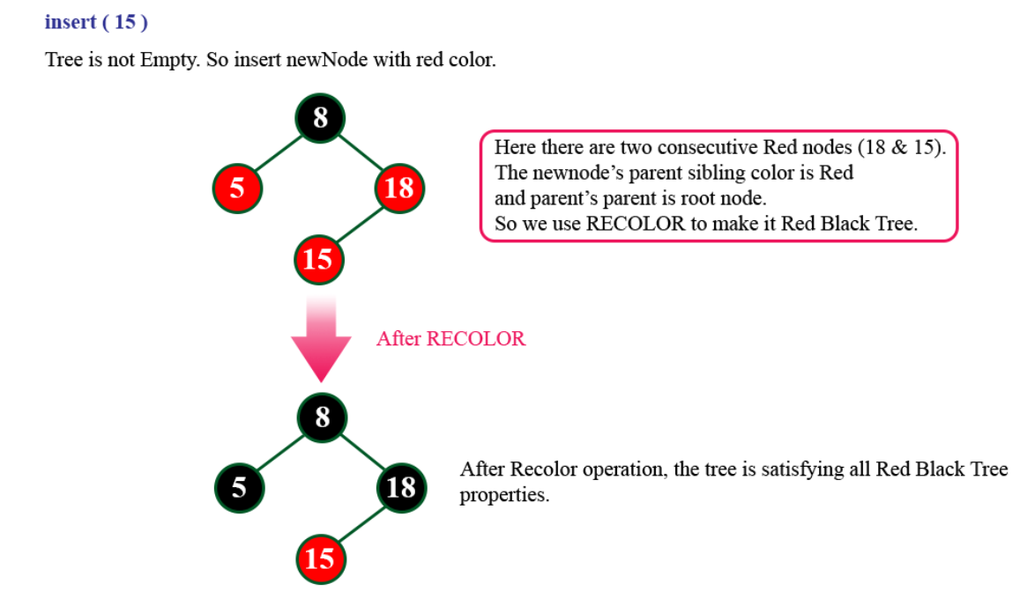

Slide 64
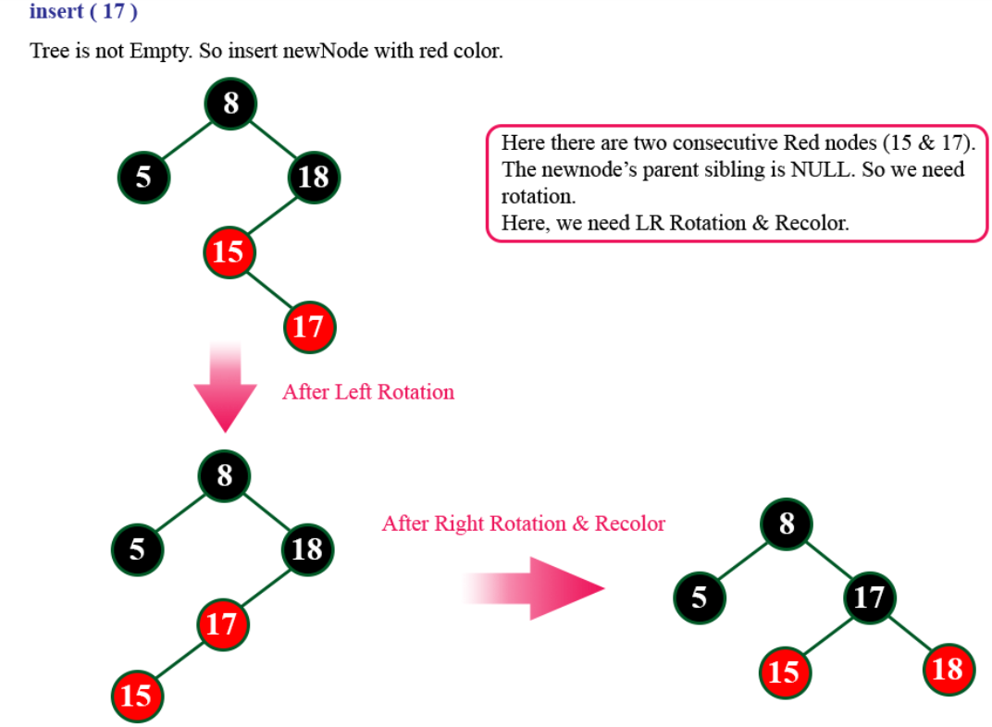

Slide 65
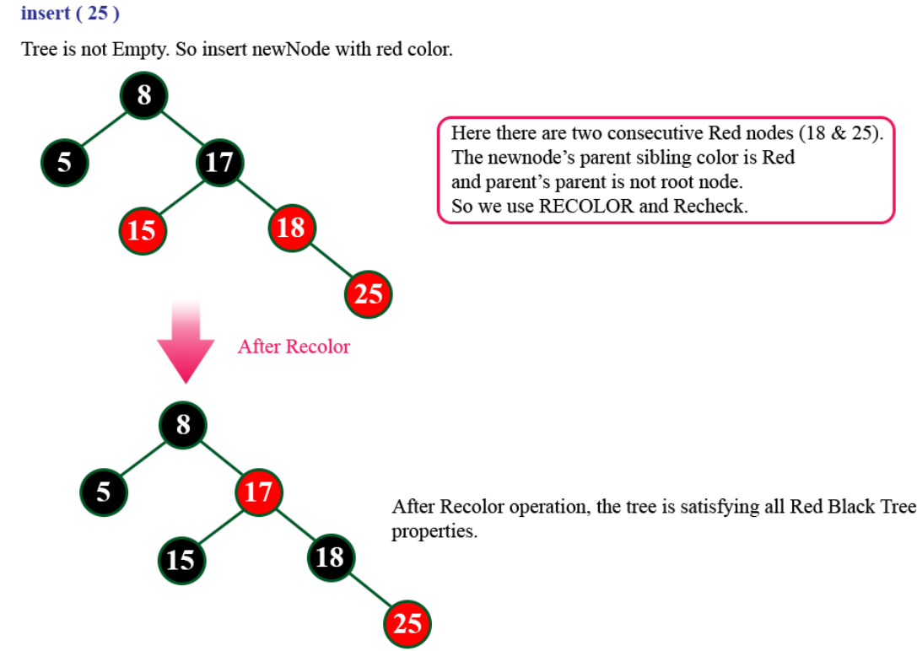

Slide 66
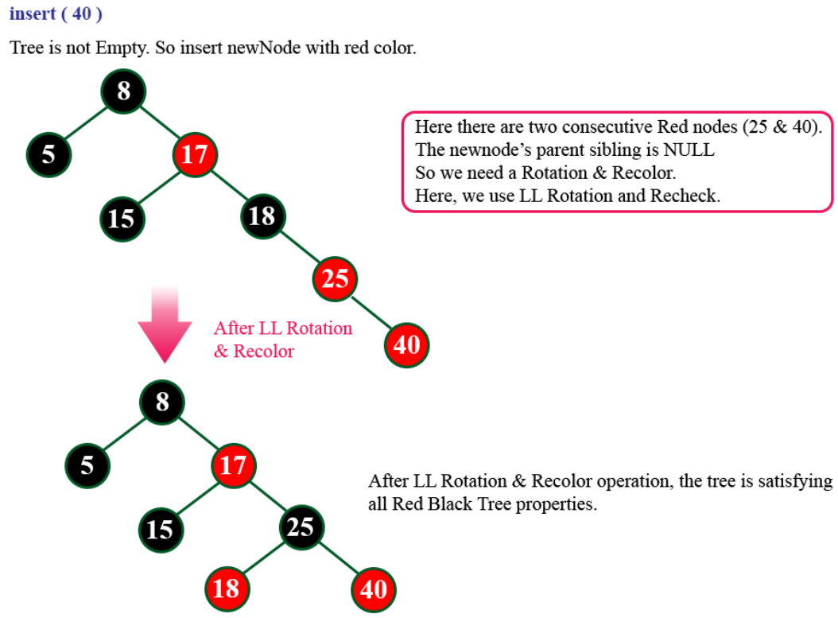

Slide 67
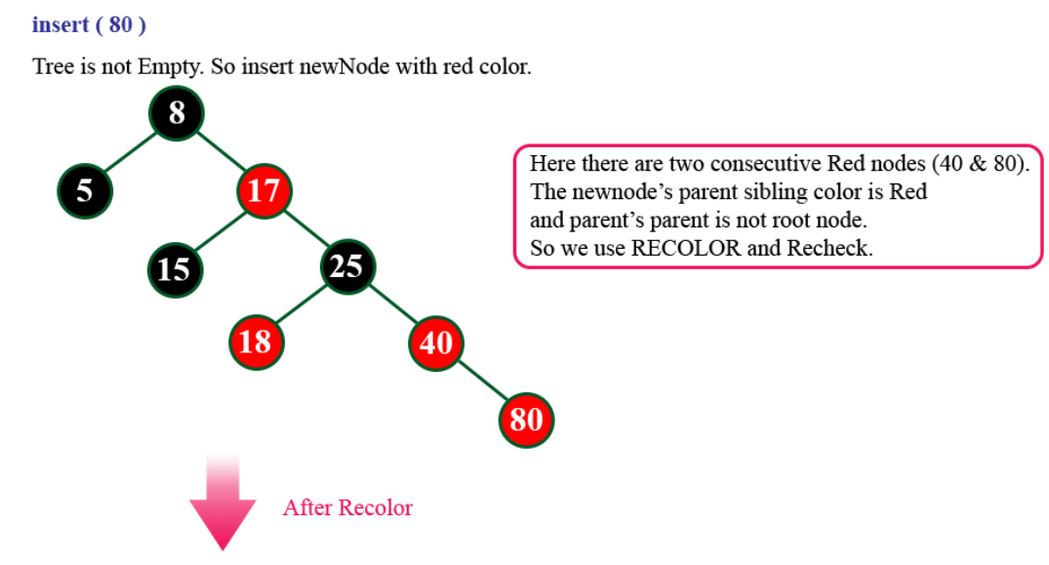

Slide 68
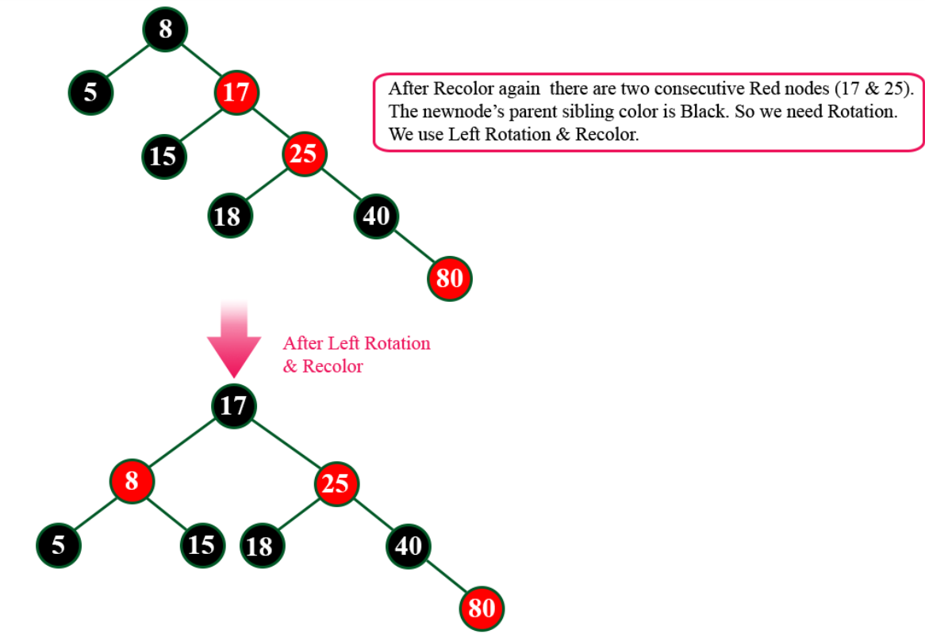

Slide 69
Construct a Red-Black Tree by inserting numbers from 1 to 7

Slide 70
Is every AVL tree can be a Red-Black tree?
Yes, every AVL tree can be a Red-Black tree if we color each node either by Red or Black color. But every Red-Black tree is not an AVL because the AVL tree is strictly height-balanced while the Red-Black tree is not completely height-balanced.

Slide 71
Is every AVL tree can be a Red-Black tree?

Slide 72
B-Trees
When data is too large to fit in main memory, then the number of disk accesses becomes important.
Secondary memory (disk) is divided into equal-sized blocks.
The basic I/O operation transfers the contents of one disk block to/from main memory.
Our goal is to devise a multiway search tree that will minimize file accesses (by exploiting disk block read).
B tree Used in Mac, NTFS, OS2 for file structure.
Allow insertion and deletion into a tree structure, based on log_{m}n property, where m is the order of the tree.
The idea is that you leave some key spaces open. So an insert of a new key is done using available space (most cases).
Less dynamic than typical Binary Tree
Ideal for disk based operations.

Slide 73
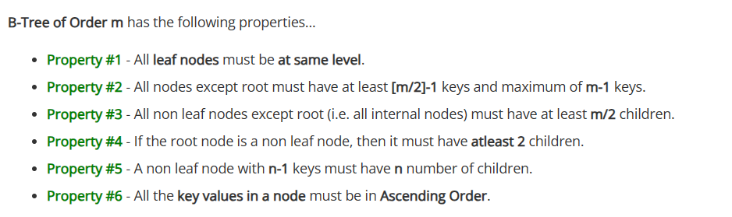
B-Trees

Slide 74
B-Tree Example with m = 5
12
2
3
8
13
27

Slide 75


Slide 76


Slide 77


Slide 78


Slide 79


Slide 80


Slide 81



Slide 82


Slide 83


Slide 84


Slide 85


Slide 86


Slide 87


Slide 88


Slide 89


Slide 90


Slide 91


Slide 92
Thank you

